Slide 1
Lecture 9: Search 8
Victor R. Lesser
CMPSCI 683 Fall 2010

Slide 2
Today’s Lecture
Another Form of Local Search
Repair/Debugging in Constraint Satisfaction Problems
GSAT
A Systematic Approach to Constraint Satisfaction Problems
Simple Backtracking Search
Informed-Backtracking Using Min-Conflicts Heuristic
Arc Consistency for Pre-processing
Other approaches to ordering variables and values in search

Slide 3
Constraint Satisfaction Problems (CSP)
A set of variables X₁…X_{n}, and a set of constraints C₁…C_{m}. Each variable X_{i} has a domain D_{i} of possible values.
A solution to a CSP: a complete assignment to all variables that satisfies all the constraints.
Representation of constraints as predicates.
Visualizing a CSP as a constraint graph.

Slide 4
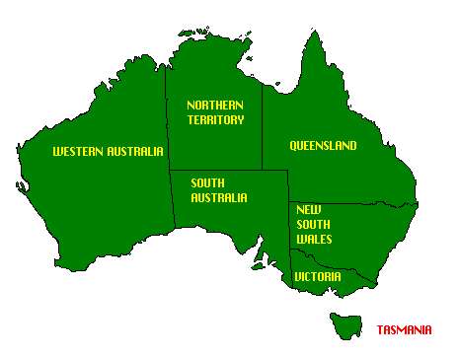
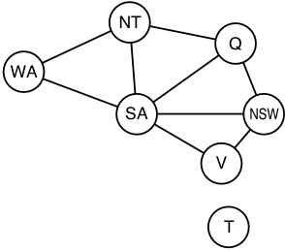
Example: Map coloring
T

Slide 5
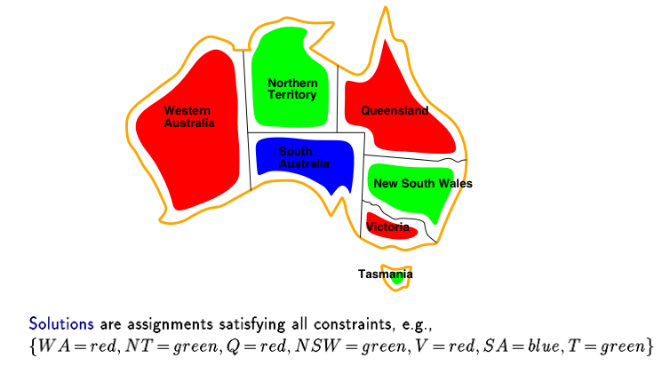
A Valid Map Assignment

Slide 6
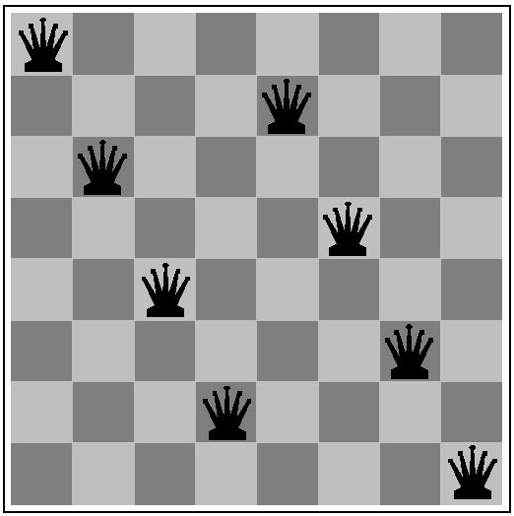
Example 3: N queens
What are the variables? domains? constraints?

Slide 7
8 queens
8 variables X_{i}, i = 1 to 8; for each column
Domain for each variable {1,2,…,8}
Constraints are:
X_{i} ≠ X_{j} for all j = 1 to 8, j≠I; not on same row
|X_{i} - X_{j}| ≠ |i - j| for all j = 1 to 8, j≠I; not on diagonal
Note that all constraints involve 2 variables
Generate-and-test with no redundancies requires “only” N^{N} combinations…

Slide 8
Task scheduling
T1
T2
T4
T3
T1 must be done during T3
T2 must be achieved before T1 starts
T2 must overlap with T3
T4 must start after T1 is complete
What are the variables? domains? constraints?

Slide 9
Non-Binary Constraints
T W O
+ T W O
F O U R
F
T
U
W
R
O
O + O = R + 10•X1
X₁ + W + W = U + 10•X₂
X₂ + T + T = O + 10•X₃
X₃ = F
alldiff(F,T,U,W,R,O)
Between0-9(F,T,U,W,R,O)
Between0-1 (X₁,X₂,X₃)
X₃
X₂
X₁
3 or more variables constraints

Slide 10
Finite vs. infinite domains
Finite domains: 8-queens, matching, cryptarithmetic, job assignment
Finite-domain ⊂ Boolean ⊂ 3SAT (NP-complete)
Infinite domains: job scheduling
Cannot enumerate all possibilities
Over the range of integers
Need a constraint language:
StartJob₁ + 5 ≤ StartJob₃
Bound range
Choice of language affects complexity

Slide 11
Constraint optimization
Representing preferences versus absolute constraints.
Weighted by constraints violated/satisfied
Constraint optimization is generally more complicated.
Can also be solved using local search techniques.
Hard to find optimal solutions.

Slide 12
Local search for CSPs: Heuristic Repair
Start state is some assignment of values to variables that may violate some constraints.
Create a complete but inconsistent assignment
Successor state: change value of one variable.
Use heuristic repair methods to reduce the number of conflicts (iterative improvement).
The min-conflicts heuristic: choose a value for a variable that minimizes the number of remaining conflicts.
Hill climbing on the number of violated constraints
Repair constraint violations until a consistent assignment is achieved.
Can solve the million-queens problem in an average of 50 steps!

Slide 13
Heuristic Repair Algorithm

Slide 14
N-Queens Heuristic Repair
Pre-processing phase to generate initial assignment
Greedy algorithm that iterates through rows placing each queen on the column where it conflicts with the fewest previously placed queens
Repair phase
Select (randomly) a queen in a specific row that is in conflict and moves it to the column (within the same row) where it conflicts with the fewest other queens

Slide 15
Example of min-conflicts: N-Queens Problem
A two-step solution of an 8-queens problem. The number of remaining conflicts for each new position of the selected queen is shown. Algorithm moves the queen to the min-conflict square, breaking ties randomly.

Slide 16
SAT- Satisfiability Problem
Given a propositional sentence, determine if it is satisfiable, and if it is, show which propositions have to be true to make the sentence true. 3SAT is the problem of finding a satisfying truth assignment for a sentence in a special format
Why are we interested in this representational framework?

Slide 17
Definition of 3SAT
A literal is a proposition symbol or its negation (e.g., P or ¬ P).
A clause is a disjunction of literals; a 3-clause is a disjunction of exactly 3 literals (e.g., P ∨ Q ∨ ¬ R ).
A sentence in CNF or conjunctive normal form is a conjunction of clauses; a 3-CNF sentence is a conjunction of 3-clauses.
For example,
(P ∨ Q ∨ ¬ S) ∧ (¬ P ∨ Q ∨ R) ∧ (¬ P ∨ ¬ R ∨ ¬ S) ∧ (P ∨ ¬ S ∨ T)
Is a 3-CNF sentence with four clauses and five proposition symbols.

Slide 18
Mapping 3-Queens into 3SAT

Slide 19
Converting N-SAT into 3-SAT
Add in dummy variable E, not interested in its truth value from problem perspective nor does its truth affect satisfiability of original proposition

Slide 20
Davis-Putnam Algorithm (Depth-First Search)
F
T
A
F
T
B
x

Slide 21
GSAT Algorithm
Problem: Given a formula of the propositional calculus, find an interpretation of the variables under which the formula comes out true, or report that none exists.
procedure GSAT
Input: a set of clauses ∝, MAX-FLIPS, and MAX-TRIES
Output: a satisfying truth assignments of ∝, if found
begin
for i:= 1 to MAX-TRIES
T := a randomly generated truth assignment
for j := 1 to MAX-FLIPS
if T satisfies ∝ then return T
p := a propositional variable such that a change in its truth assignment gives the largest increase in total number of clauses of ∝ that are satisfied by T.
T := T with the truth assignment of p reversed
end for
end for
return “no satisfying assignment found”
end

Slide 22
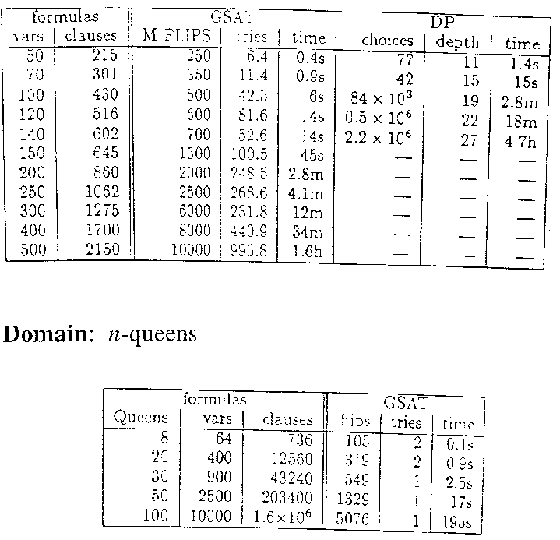
GSAT Performance
GSAT versus Davis-Putnam
(a backtracking style algorithm)
Domain: hard random 3CNF formulas, all satisfiable (hard means chosen from a region in which about 50% of problems are unsolvable)

Slide 23
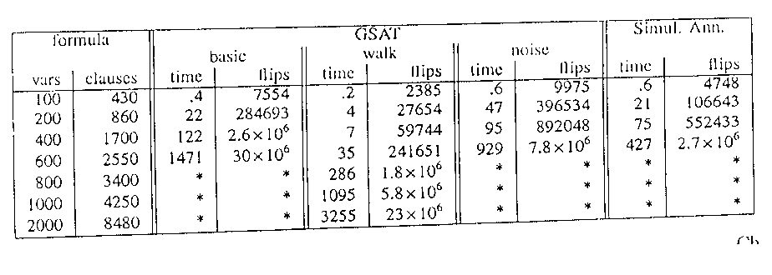
GSAT Performance (cont’d)
GSAT Biased Random Walk
With probability p, follow the standard GSAT scheme,
i.e., make the best possible flip.
With probability 1 - p, pick a variable occurring in some unsatisfied clause and flip its truth assignment. (Note: a possible uphill move.)
GSAT-Walk < Simulated-Annealing < GSAT-Noise < GSAT-Basic
Comparing noise strategies on hard random 3CNF formulas. (Time in seconds on an SGI Challenge)

Slide 24
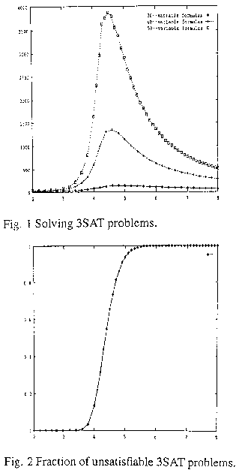
3SAT Phase Transition
Easy -- Sastifiable problems where many solutions
Hard -- Sastifiable problems where few solutions
Easy -- Few Satisfiable problems
Assumes concurrent search in the satisfiable space and the non-satisfiable space ( negation of proposition)
20--variable formulas ♦
40--variable formulas +
50--variable formulas 
Fraction of unsatisfiable formulae
# of DP calls
Ratio of clauses-to-variables
Ratio of clauses-to-variables

Slide 25
Constraint Satisfaction Problems (CSP)
A set of variables X₁…X_{n}, and a set of constraints C₁…C_{m}. Each variable X_{i} has a domain D_{i} of possible values.
A solution to a CSP: a complete assignment to all variables that satisfies all the constraints.
Representation of constraints as predicates.
Visualizing a CSP as a constraint graph.

Slide 26
A Simplistic Approach to Solving CSPs using Systematic Search
Initial state: the empty assignment
Successor function: a value can be assigned to any variable as long as no constraint is violated.
Goal test: the current assignment is complete.
Path cost: a constant cost for every step. – not relevant

Slide 27
What more is needed?
Not just a successor function and goal test
But also a means to propagate the constraints imposed by variables already bound along the path on the potential fringe nodes of that path and an early failure test
Thus, need explicit representation of constraints and constraint manipulation algorithms

Slide 28
Exploiting Commutativity
Naïve application of search to CSPs:
If use breath first search
Branching factor is n•d at the top level, then (n-1)d, and so on for n levels (n variables, and d values for each variable).
The tree has n!•d^{n} leaves, even though there are only d^{n} possible complete assignments!
Naïve formulation ignores commutativity of all CSPs: the order of any given set of actions has no effect on the outcome.
[WA=red, NT=green] same as [NT=green, WA=red]
Solution: consider a single variable at each depth of the tree.

Slide 29
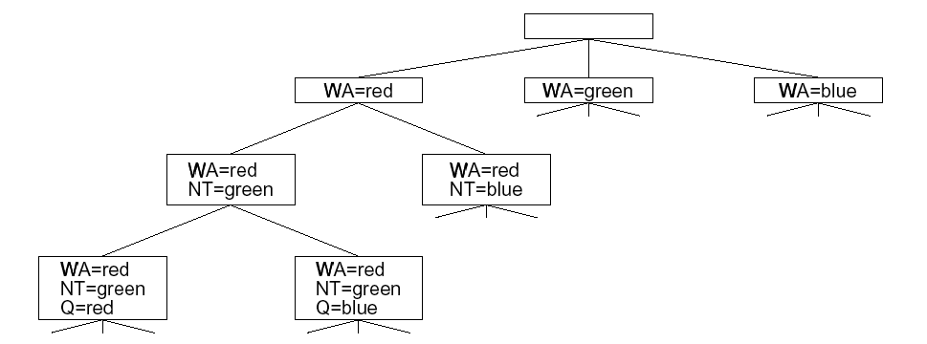
Part of the map-coloring search tree
Variable 1 - WA
Variable 2 -- NT
Variable 3 -- Q

Slide 30
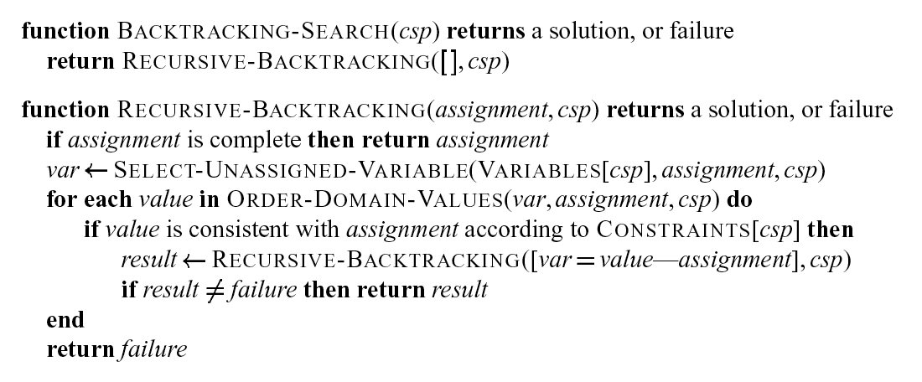
Depth-First CSP Search with Single-Variable Assignments -- Backtracking Search
; Expand depth-first
Recursion implicitly holds the search tree and the possibilities that have not been explored

Slide 31
Heuristics that can help
Key questions:
Which variable should be assigned next and in what order should the values be tried?
What are the implications of the current variable assignments for the other unassigned variables?
When a path fails, can the search avoid repeating this failure in subsequent paths?

Slide 32
Informed-Backtracking Using Min-Conflicts Heuristic
Procedure INFORMED-BACKTRACK (VARS-LEFT VARS-DONE)
If all variables are consistent, then solution found, STOP.
Let VAR = a variable in VARS-LEFT that is in conflict.; HOW TO CHOOSE?
Remove VAR from VARS-LEFT.
Push VAR onto VARS-DONE.
Let VALUES = list of possible values for VAR ordered in ascending order according to number of conflicts with variables in VARS-LEFT. – min-conflict heuristic
For each VALUE in VALUES, until solution found:
If VALUE does not conflict with any variable that is in VARS-DONE,
then Assign VALUE to VAR.
Call INFORMED-BACKTRACK(VARS-LEFT VARS-DONE); DEPTH-FIRST RECURSION
end if
end for; WHAT HAPPENS IF YOU DON’T FIND ACCEPTABLE VALUE?
end procedure
Begin program (INITIALIZATION OF RECURSIVE BACKTRACKING)
Let VARS-LEFT = list of all variables, each assigned an initial state
Let VARS-DONE = nil
Call INFORMED-BACKTRACK(VARS-LEFT VARS-DONE)
End program

Slide 33
Number of backtracks/repairs for N-Queens algorithms (S. Minton et al.)
Constructive Repair-based
Standard Most constrained Min-conflicts Min-conflicts
n backtrack backtrack¨ hill-climbing backtrack
n = 10¹ 53.8 17.4 57.0 46.8
n = 10² 4473 (70%) 687 (96%) 55.6 25.0
n = 10³ 88650 (13%) 22150 (81%) 48.8 30.7
n = 10^{4 * *} 48.5 27.5
n = 10^{5 * *} 52.8 27.8
n = 10⁶ * * 48.3 26.4
* = exceeded computation resources

Slide 34
Number of backtracks/repairs for N-Queens algorithms (S. Minton et al.)
Constructive Repair-based
Standard Most constrained Min-conflicts Min-conflicts
n backtrack backtrack¨ hill-climbing backtrack
n = 10¹ 53.8 17.4 57.0 46.8
n = 10² 4473 (70%) 687 (96%) 55. 25.0
n = 10³ 88650 (13%) 22150 (81%) 48.8 30.7
n = 10^{4 * *} 48.5 27.5
n = 10^{5 * *} 52.8 27.8
n = 10⁶ * * 48.3 26.4
* = exceeded computation resources Number of Flips
How can the measures go down with more queens?

Slide 35
Analyzing the N-Queen Slide
Using Greedy Initialization Algorithm the number of conflicts on average for million queens is 12.8, 12.02 for 100,000 queens, 10.96 for 10,000 queens.
Problem is not harder for more queens because approximately same number of conflicts
Can even be easier because of more solutions available for large number of queens or less plausible moves for conflicts? -- my thought!!
Hill climbing only slightly worse because it can move the same queen repeatedly
The cost of making a repair can be speed up in min-conflict by keeping some history of what were the conflicts in the previous cycle and meta-information about columns and row and diagonals.

Slide 36
Potential Reasons for Heuristic Repair to be Advantageous
Depth-first search badly organized
Poorer choices are explored first at each branch point
More solutions with first queen placed in center of first row
Takes a very long time to recover from bad decision made early in search
Backtracking program that randomly orders rows (and columns within rows) still performs poorly
Distribution of solutions
Depth first does not perform well where solutions clustered in tree
Random backtracking (Las Vegas algorithm) does better but still problem

Slide 37
Potential Reasons for Heuristic Repair to be Advantageous (cont’d)
Informedness hypothesis
Heuristic repair is better because it has more information that is not available to a constructive backtracking (more encompassing view of search space)
Mini-conflict heuristic — select a variable that is in conflict and assign it a value that minimizes the number of conflicts (number of other variables that will need to be repaired)

Slide 38
Some Additional Ideas on CSP Search
Arc Consistency for Pre-processing
Other approaches to ordering variables and values in search

Slide 39
Constraint propagation …
… is the process of determining how the possible values of one variable affect the possible values of other variables
The placement of the two queens makes the placement of queens in the black dots invalid

Slide 40
Forward Checking: A Simple kind of Propagation
After a variable X is assigned a value v, look at each unassigned variable Y that is connected to X by a constraint and deletes from Y’s domain any value that is inconsistent with v
Reduces the branching factor and help identify failures early.

Slide 41
Map coloring
NT
Q
WA
NSW
T
SA
V
WA | NT | Q | NSW | V | SA | T
RGB | RGB | RGB | RGB | RGB | RGB | RGB

Slide 42
Map coloring
NT
Q
WA
NSW
T
SA
V
WA | NT | Q | NSW | V | SA | T
RGB | RGB | RGB | RGB | RGB | RGB | RGB
R | GB | RGB | RGB | RGB | GB | RGB

Slide 43
Map coloring
NT
Q
WA
NSW
T
SA
V
WA | NT | Q | NSW | V | SA | T
RGB | RGB | RGB | RGB | RGB | RGB | RGB
R | GB | RGB | RGB | RGB | GB | RGB
R | B | G | RB | RGB | B | RGB

Slide 44
Map coloring
NT
Q
WA
NSW
T
SA
V
Impossible assignments that forward
checking does not detect
WA | NT | Q | NSW | V | SA | T
RGB | RGB | RGB | RGB | RGB | RGB | RGB
R | GB | RGB | RGB | RGB | GB | RGB
R | B | G | RB | RGB | B | RGB
R | B | G | R | B |  | RGB

Slide 45
Next Lecture
Continuation of Systematic Search for CSPs
Intelligent backtracing
Reducing the Search by structuring the CSP as a tree search
Extending the model of simple heuristic seach
Interacting subproblem perspective
Multi-level Search
BlackBoard Problem Solving Architecture

